Slide 1

Project Title - Network Port Scanner GUI
Student Name- Gangode Prathmesh Raghunath
AICTE ID- STU68f9f4033b6691761211395

Slide 2

PROBLEM STATEMENT
Understanding how port scanning works
Using command-line tools effectively
Visualizing scan results in a simple and readable format
Additionally, there is a lack of lightweight, easy-to-use graphical tools that:
Provide real-time feedback
Require minimal setup
Are built using basic programming concepts for learning purposes

Slide 3
Project Description The Network Port Scanner GUI is a lightweight and user-friendly cybersecurity tool developed using Python and Tkinter. The primary purpose of this application is to scan a target system (IP address or hostname) and identify open TCP ports within a specified range. The graphical user interface simplifies the scanning process by allowing users to input only three parameters: Target IP/Hostname Start Port End Port This project demonstrates practical implementation of: Socket programming Multi-threading GUI development Network fundamentals

Slide 4

WHO ARE THE END USERS?
Students & Learners
Computer science and cybersecurity students
Useful for understanding networking concepts like ports, protocols, and services
Cybersecurity Beginners
Individuals learning ethical hacking and penetration testing
Helps in practicing basic reconnaissance techniques
IT Professionals
Useful for troubleshooting network issues
Verifying whether specific services are running on expected ports

Slide 5

Technology Used
Python
Core programming language used for building the application
Provides libraries for networking and threading
Tkinter
Built-in Python library for GUI development
Used to create the application interface (buttons, input fields, progress bar, etc.)

Slide 6
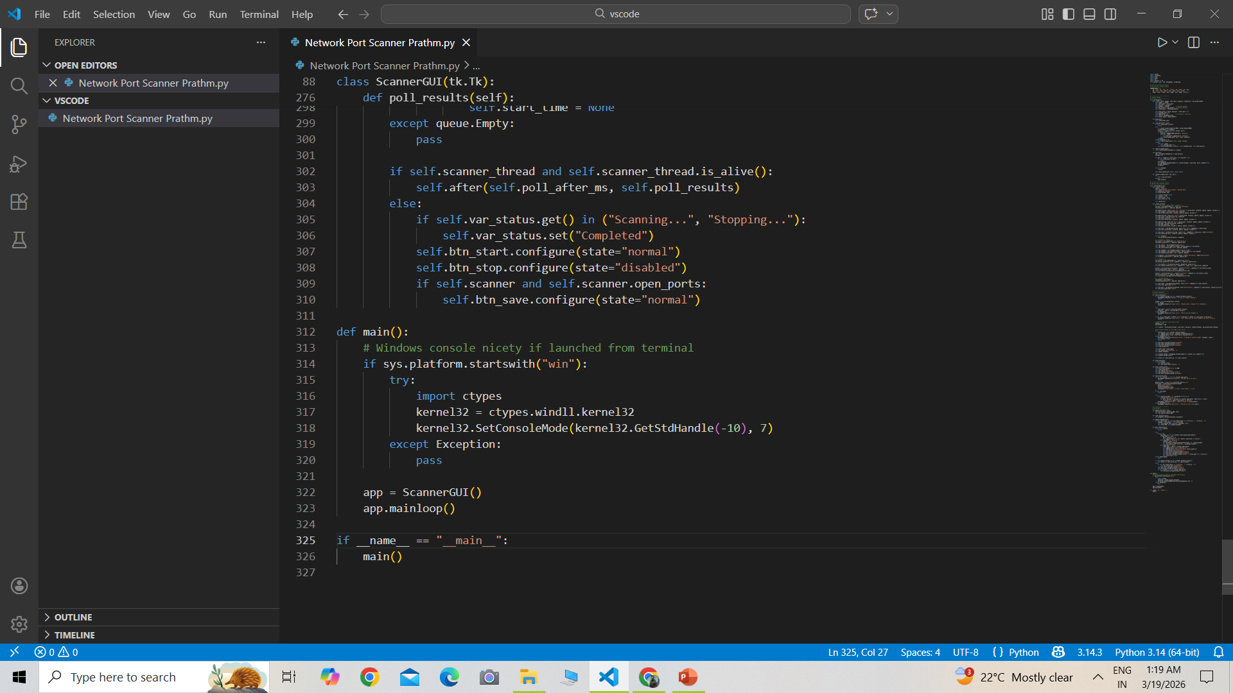
RESULTS
Demo Link

Slide 7
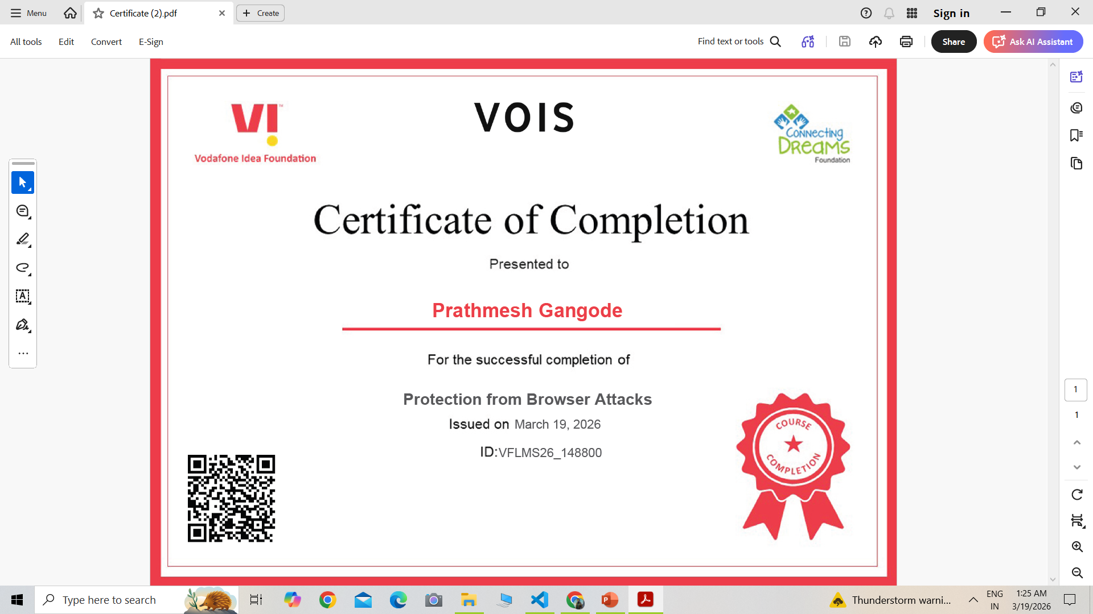
Certificate - Protection from browser attacks

Slide 8
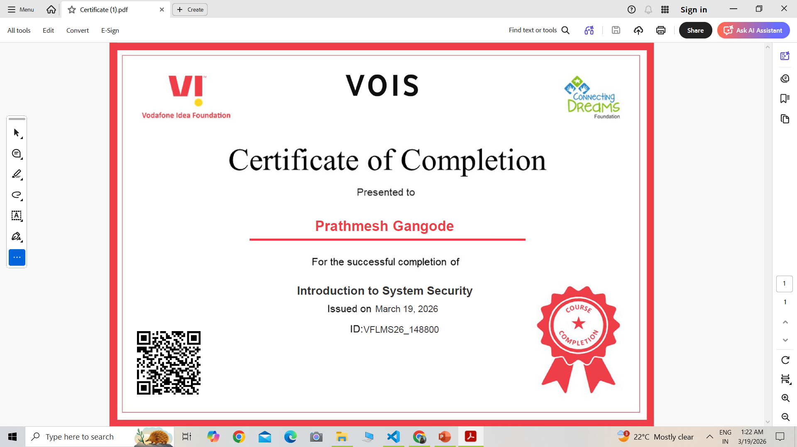
Certificate - Introduction to System Security

Slide 9
GitHub link
https://github.com/Prathmg/Network-Port-Scanning-Report

Slide 10
Thank you
Student Name- Gangode Prathmesh Raghunath
AICTE ID- STU68f9f4033b6691761211395
https://github.com/Prathmg/Network-Port-Scanning-Report
.
.

